Slide 1
Stronger Mixed-Size Placement Backbone Considering Second-Order Information
Yifan Chen, Zaiwen Wen, Yun Liang, Yibo Lin
Peking University, China
Presenter : Min-Feng Hsieh
Adviser : Ting-Chi Wang
Notes:
上海鐳達晶元智慧科技有限公司
復旦大學專用積體電路與系統國家重點實驗室

Slide 2
Outline
Abstract
Introduction
Preliminaries
Proposed Algorithm
Congestion Estimation
Cell Padding
Strategy Exploration
Legalization
Experimental Result

Slide 3
Introduction
Macro placement significantly effects the eventual quality of the placement result.
Existing analytical placement algorithm may fail if the parameter is not well-tuned.
Some mixed-size placement algorithms leverage mathematical optimization.
mPL6, NTUplace, ePlace-MS
Some research focuses on efficient data structures to represent a macro placement.
CG, MP-tree, CP-tree

Slide 4
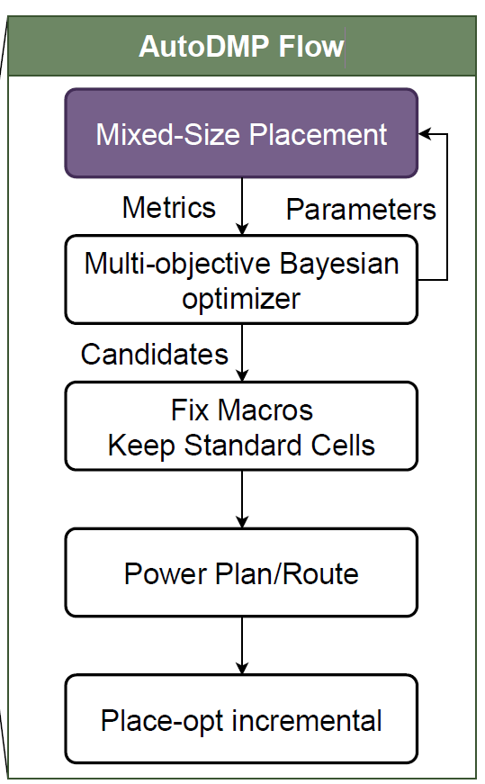
Introduction
Some machine learning techniques have also been proposed.
Macro placement solutions based on routability prediction.
Graph learning based initialization for mixed-size placement.
Reinforcement learning for macro refinement.
AutoDMP apply DREAMPlace to performs hyper-parameter searching upon a mixed-size placement.
Considering the congestion and the WL.

Slide 5
Introduction
The macros’ motion will cause drastic changes in the gradient due to their heterogeneous sizes.
Most mixed-size placement algorithms rely on first-order gradient information
They aim to address the convergence issue by considering second-order

Slide 6
Outline
Abstract
Introduction
Preliminaries
Proposed Algorithm
Congestion Estimation
Cell Padding
Strategy Exploration
Legalization
Experimental Result

Slide 7
Preliminaries - Analytical Mixed-Size Placement
Including three stages:
Global placement
Legalization
Detail placement
Notes:
GR: 將instance分散到layout中
Legalization: 將instance中的overlap消除並且進行alignment
DR: further improve the quality

Slide 8
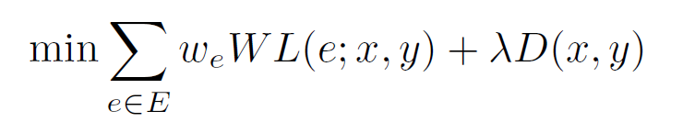

Preliminaries - Analytical Mixed-Size Placement
We can formulate analytical global routing problem as:
${ w}_{e}:$ weight of net e
$WL\left(e; x, y\right):$wirelength
$D\left(x, y\right):$ Density penalty to spread cells
λ : Density penalty factor

Slide 9
Preliminaries – Macro Legalzation
Legalization stage will ensure non-overlapping with minimum displacement.
The legalization will be divided into two parts:
Macro legalization
Instance legalization
Mainly focus on macro legalization in this paper.

Slide 10
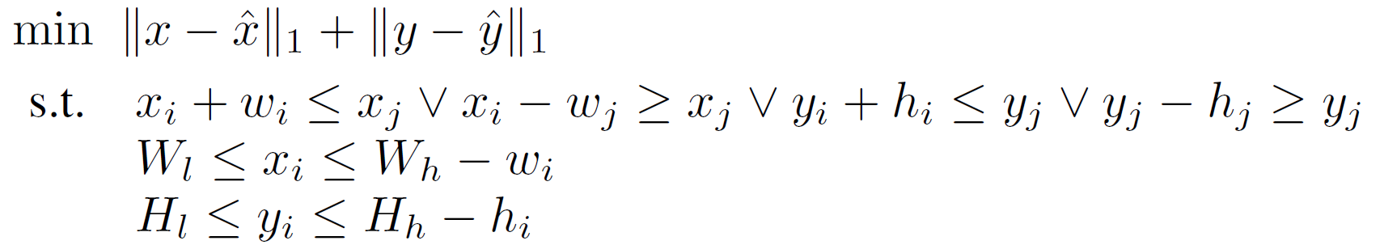

Preliminaries – Macro Legalization
Macro legalization can be formulated as following.
($\hat{x}, \hat{y}$)$:$ The coordinates before legalization
($w_{i}, h_{i}$): The width and height of the instance i
$W_{l }(W_{h}):$ the left (right) boundary of the layout
${ H}_{l} (H_{h})$ : the bottom (top) boundary of the layout

Slide 11
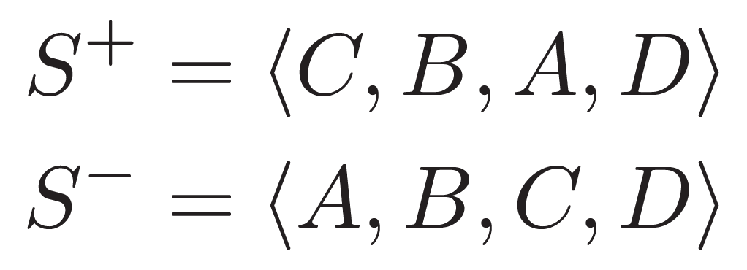
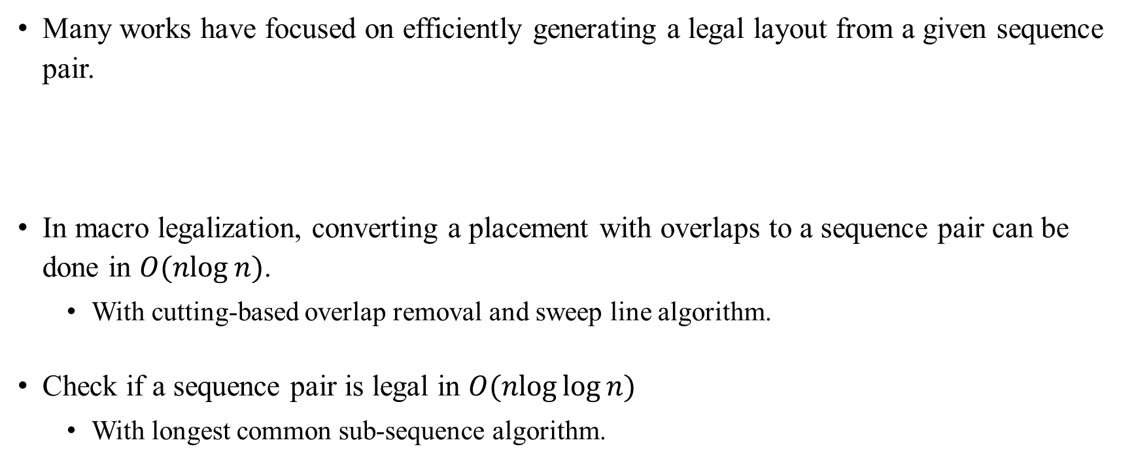
Preliminaries – Sequence Pair
Many works have focused on efficiently generating a legal layout from a given sequence pair.
In macro legalization, converting a placement with overlaps to a sequence pair can be done in $O(nlog⁡n)$.
With cutting-based overlap removal and sweep line algorithm.
Check if a sequence pair is legal in $O(nlog⁡log⁡n)$
With longest common sub-sequence algorithm.

Slide 12
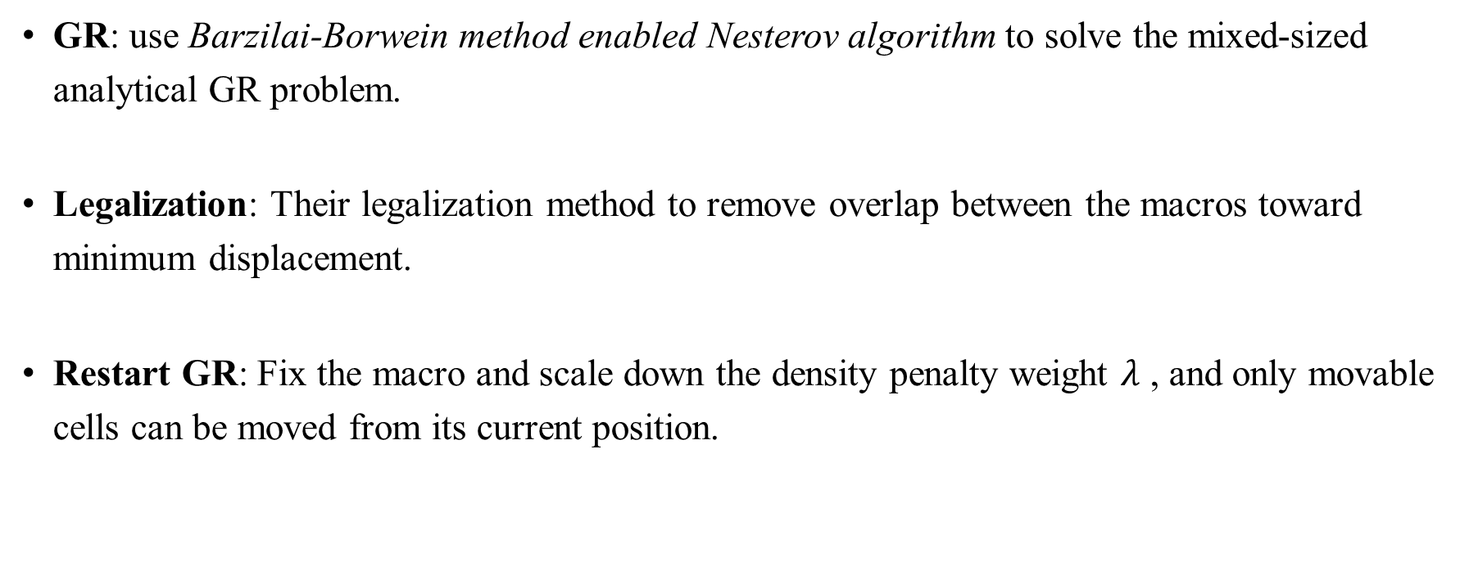
Algorithm
GR: use Barzilai-Borwein method enabled Nesterov algorithm to solve the mixed-sized analytical GR problem.
Legalization: Their legalization method to remove overlap between the macros toward minimum displacement.
Restart GR: Fix the macro and scale down the density penalty weight $λ$ , and only movable cells can be moved from its current position.

Slide 13
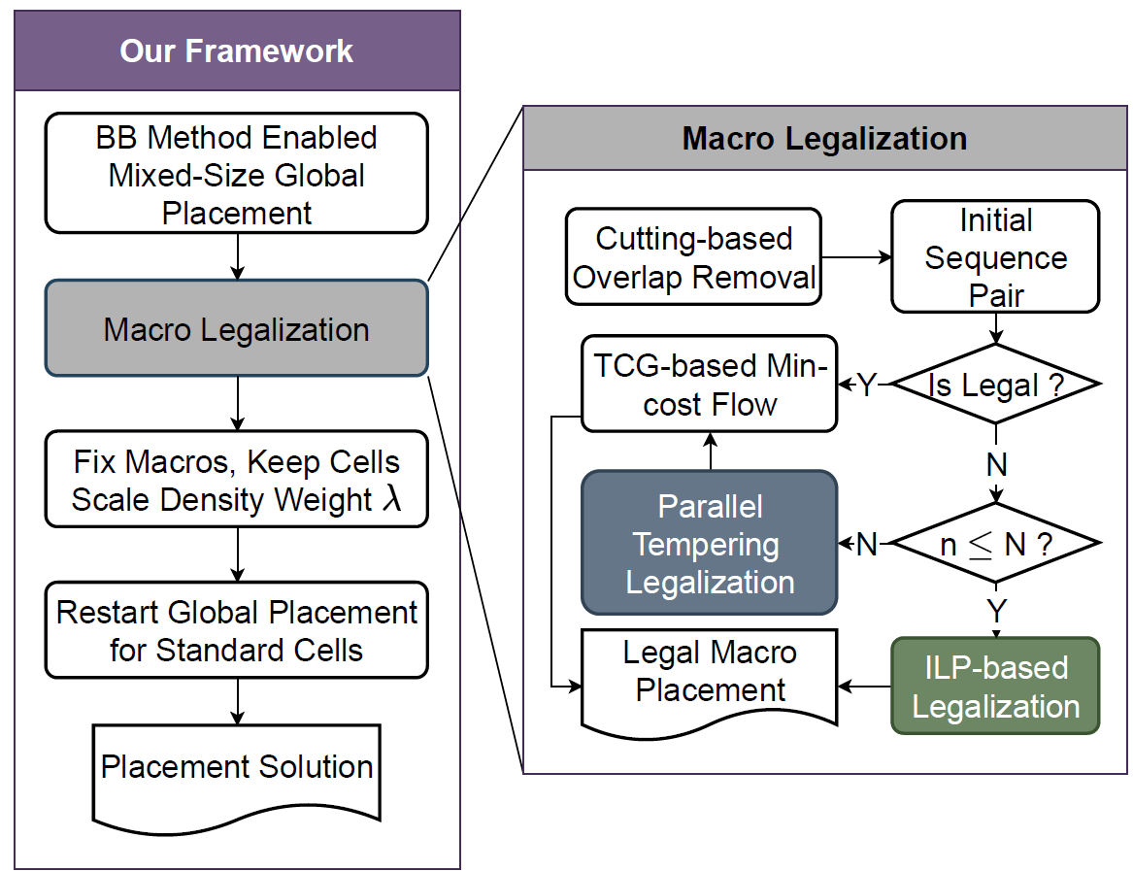
Algorithm

Slide 14
Thank you for listening!

